Slide 1
Microsoft Ignite

Slide 2
Storing Data in Azure
AFUN50

Slide 3
Resources
Session Resources
aka.ms/AFUN50
Session Code on GitHub
aka.ms/AFUN50Repo
All Event Resources
aka.ms/mymsignitethetour

Slide 4
Let’s focus on storage in Azure
Why cloud storage?
Introduction to cloud storage options
Demo - Creating data stores in Azure Portal
Introduction to Cosmos DB
Demo - Cosmos DB
SQL Server, PostgreSQL, and MySQL in Azure
Azure Data Factory and SQL Data Warehouse
Demo - Data migration pipeline with Azure Data Factory

Slide 5
Storage in Azure: The Basics

Slide 6
Why Cloud Storage?
Different strategies for different data source - blob, tables, relational, NoSQL etc
Make sure that my database is always available
Tune and maintain my database for predictable performance
Access / share / update data regardless of data type and device
Anywhere in the world
Quick access from around the world due to replication and multiple data centers
Keeping data persistent, highly accessible, secure is not trivial
Storage tiers
Cloud based storage offer standard APIs to access data
Monitor, troubleshoot, and manage at scale
Fully Managed DB benefits
Automated backup and recovery

Slide 7
Azure at a Glance
Edge Devices
Azure Stack
Azure Data Box
Azure Sphere
Azure Kinect
HoloLens
Serverless
Web
Mobile
Mixed Reality
Containers
Events + Integration
Databases
Analytics
AI + Machine Learning
Internet of Things
Media
Tools
Visual Studio
GitHub
PowerApps
Power BI
Infrastructure
Compute
Networking
Storage
Security
Identity

Slide 8






The Modern Data Estate
Hybrid
On-premises
Cloud
Operational databases
Data warehouses
Data lakes
Operational databases
Data warehouses
Data lakes
Reason over any data, anywhere
Flexibility of choice
Security and performance
R
JAVA

Slide 9
Azure Data Storage vs On-premises Storage
Cost effectiveness:
On-premises requires dedicated hardware which needs to handle peak demand
Azure data storage is pay-as-you-go and scalable – ready for demand fluctuations
Reliability:
On-premises requires backup, load balancing, and disaster recovery
Azure data storage provides these services as built-in services
Storage types:
Azure data storage supports multiple different storage options, removing the need to configure different server and administrative software on an on-premises server

Slide 10




Azure Storage Account in the Cloud
Blobs
Files
Queues
Tables
Disks
Object storage
access via REST
File storage
access via SMB, REST
Reliable messaging
access via REST
NOSQL storage
access via REST
IaaS VM VHD/ disks
access via REST
Streaming & random object access scenarios
Lift & shift scenarios
Scheduling async tasks
Key / Value Store
Persistent disks for VMs
Built on a unified and distributed storage system
Durability, encryption at rest, strongly consistent replication, fault tolerance, auto load-balancing

Slide 11


Encryption
Microsoft Azure includes tools to safeguard data according to your company’s security and compliance needs
Azure Storage Service Encryption automatically and transparently encrypts data before persisting it
Enabled by default, and provided at no additional cost
Available for managed disks, blob storage, files, queues, and tables
Azure
Data Center
Storage
Azure
Portal
Azure
Data Center
Encryption management

Slide 12
Redundancy and Replication
Zone 1
Zone 2
Zone 3
Async
Primary
Secondary
Async
Primary
Secondary
LRS
(Locally Redundant Storage)
ZRS
(Zone Redundant Storage)
GRS
(Geo Redundant Storage)
RA-GRS
(Read Access – Geo Redundant Storage)
3 replicas, 1 region
3 replicas across 3 Zones
6 replicas, 2 regions (3/region)
GRS + Read access to secondary

Slide 13
Demo: Creating Data Stores in Azure

Slide 14
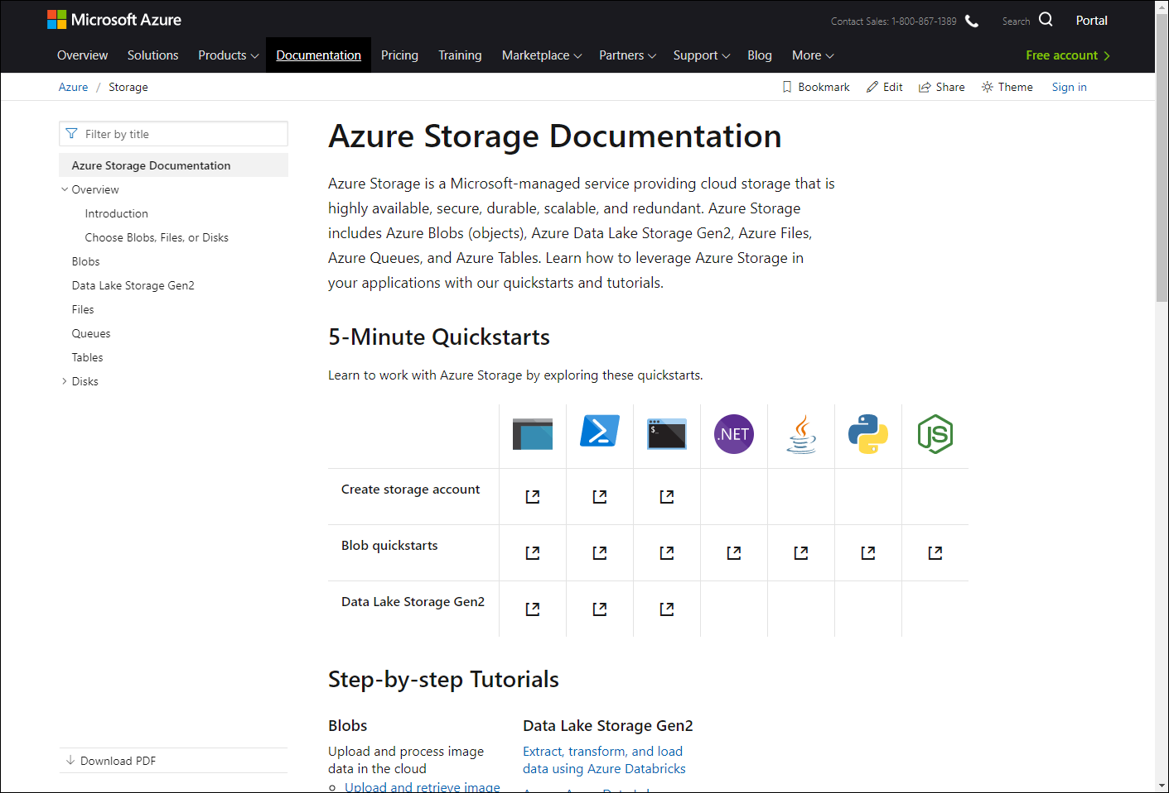
/Docs alert
Explore overviews, tutorials, samples, and more.
aka.ms/storagedocs-afun50

Slide 15
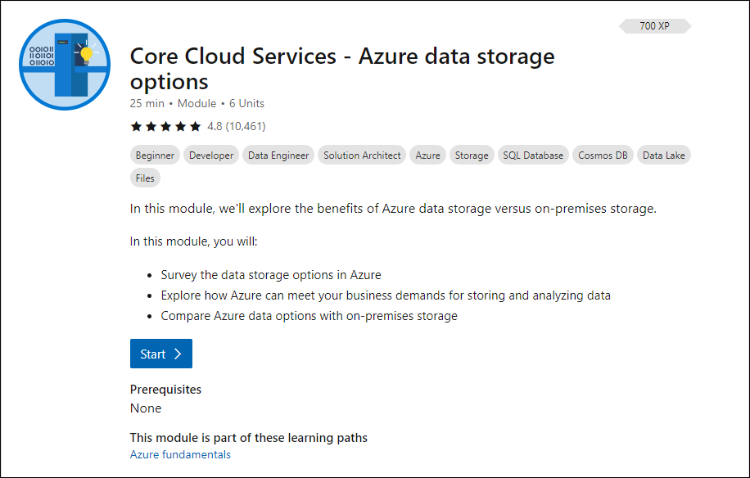
/MS Learn alert
Survey data storage options in Azure Storage and compare with on-premises storage
aka.ms/AFUN50MSLearnCollection

Slide 16
Introduction to Cosmos DB

Slide 17

The Modern Data Estate
Microsoft’s cloud solution
Operational databases
Data lakes & analytics
Azure SQL Database
for relational data
Azure Data Lake
for processing and analytics on data of any size, shape, and speed
Azure Data Services
Azure Cosmos DB
for non-relational/NoSQL data
Azure Databricks
for big data analytics and AI solutions
Data warehouses
Azure databases for MySQL, PostgreSQL, and MariaDB
for open source
Azure SQL Data Warehouse
for complex queries across petabytes of data
Azure HDInsight
for open source analytics
Reason over any data, anywhere
Security and performance
Flexibility of choice

Slide 18





Azure Cosmos DB
Core (SQL) API
Table API
MongoDB
Column-family
Document
Key-value
Graph
Guaranteed low latency at the 99th percentile
Elastic scale out
of storage & throughput
Five well-defined consistency models
Turnkey global distribution
Comprehensive SLAs

Slide 19
Powering global solutions
Azure Cosmos DB was built to support modern app patterns and use cases.
It enables industry-leading organizations to unlock the value of data, and respond to global customers and changing business dynamics in real-time.
Data distributed and available globally
Build real-time customer experiences
Ideal for gaming, IoT & eCommerce
Simplified development with serverless architecture
Run Spark analytics over operational data
Lift and shift NoSQL data
Puts data where your users are
Enable latency-sensitive personalization, bidding, and fraud detection.
Predictable and fast service, even during traffic spikes
Fully-managed event-driven micro-services with elastic computing power
Accelerate insights from fast, global data
Lift and shift MongoDB and Cassandra workloads

Slide 20
Turnkey Global Distribution
High Availability
Automatic and Manual Failover
Multi-homing API removes need for app redeployment
Low Latency (anywhere in the world)
Packets cannot move fast than the speed of light
Sending a packet across the world under ideal network conditions takes 100’s of milliseconds
You can cheat the speed of light – using data locality
CDN’s solved this for static content
Azure Cosmos DB solves this for dynamic content

Slide 21
Demo: Cosmos DB in the Azure Portal

Slide 22
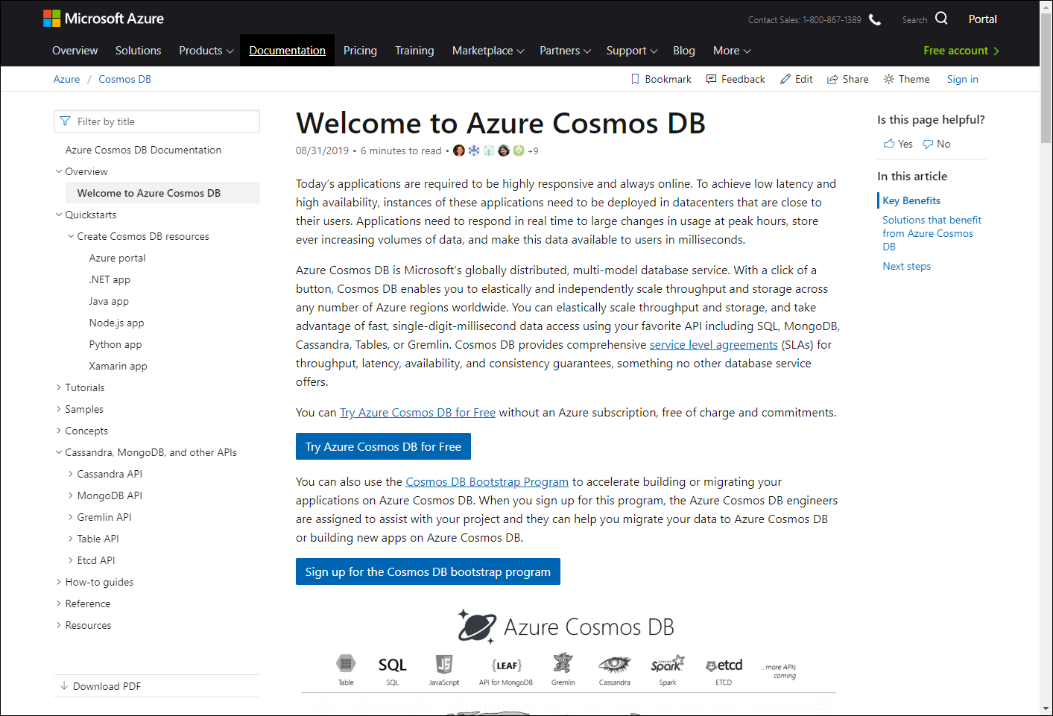
/Docs alert
Explore overviews, tutorials, samples, and more.
aka.ms/azcosmosdb-afun50

Slide 23
SQL Server, PostgreSQL, and MySQL in Azure

Slide 24
The Modern Data Estate
Microsoft’s cloud solution
Operational databases
Data lakes & analytics
Azure SQL Database
for relational data
Azure Data Lake
for processing and analytics on data of any size, shape, and speed
Azure Data Services
Azure Cosmos DB
for non-relational/NoSQL data
Azure Databricks
for big data analytics and AI solutions
Data warehouses
Azure databases for MySQL, PostgreSQL, and MariaDB
for open source
Azure SQL Data Warehouse
for complex queries across petabytes of data
Azure HDInsight
for open source analytics
Reason over any data, anywhere
Security and performance
Flexibility of choice

Slide 25
Azure SQL Database
The best and most economical cloud destination for your SQL Server
Seamless and compatible
Breakthrough productivity & performance
Industry-leading security
Built-in intelligence
Competitive TCO
The broadest SQL Server compatibility and VNET support
Up to 80% savings with Azure Hybrid Benefit and reserved capacity
Up to 100 TB of on-demand scalable storage per DB
Layers of security and 99.99 percent availability SLA
Intelligent performance tuning and intelligent protection

Slide 26
Introducing Azure SQL Database Managed Instance
Azure SQL Database
Single
Elastic Pool
Managed Instance
Database-scoped deployment option with predictable workload performance
Shared resource model optimized for greater efficiency of multi-tenant applications
Instance-scoped deployment option with high compatibility with SQL Server and full PaaS benefits

Slide 27
Azure SQL Database Managed Instance
Combining the best of SQL Server with the benefits of a fully-managed, intelligent service
Full SQL Server surface area
Native VNET integration
Always up to date
Built-in HA with Always-on
99.99% SLA out of the box
Built-in intelligent performance and security
Migrating to Managed Instance means virtually no code changes to your apps

Slide 28
Machine Learning Services in Azure SQL Database
Machine learning outside of database
In-database machine learning
Predictions
Scoring
Applications
Separate service or embedded logic
Applications
Transactions
Predictions
New data
Model operationalization
Transactions
Data transformations
Data transformations
Model training
Model
Model training
Analytics service
Scoring
Model
Data movement
DB
Azure SQL Database

Slide 29



Database migration journey
Assess
Migrate
Optimize
Secure and manage
Involve stakeholders
Calculate your TCO
Discover and evaluate apps
Select a migration strategy
Find recommended tools
Apply the migration strategy
Analyze your costs
Save with offers
Reinvest to do more
Industry-leading security
Protect your data
Monitor cloud health
On-premises
Azure
Migrate applications as-is for the benefits of the cloud without the risks or costs of making code changes
Take advantage of infrastructure as a service (IaaS) and platform as a service (PaaS) with no wholesale code changes
Modernize your app into a resilient, highly scalable, independently deployable architecture
Rebuild an application from scratch using cloud-native technologies
Refactor
Rearchitect
Rebuild

Slide 30
Azure Database Migration Service Accelerate your transition to Azure
Homogeneous sources
Heterogeneous sources
Orchestration
Scale migration
Near-zero downtime
A seamless, end-to-end solution for moving on-premises databases to Azure

Slide 31











Azure Database Services for MySQL, PostgreSQL and MariaDB
More choices and full integration into Azure’s ecosystem and services
Managed community MySQL, PostgreSQL, and MariaDB
Languages and frameworks of your choice
Scale in seconds with built-in high availability
Secure and compliant
Industry-leading global reach
My
Easy Lift and Shift
Enterprise Ready

Slide 32
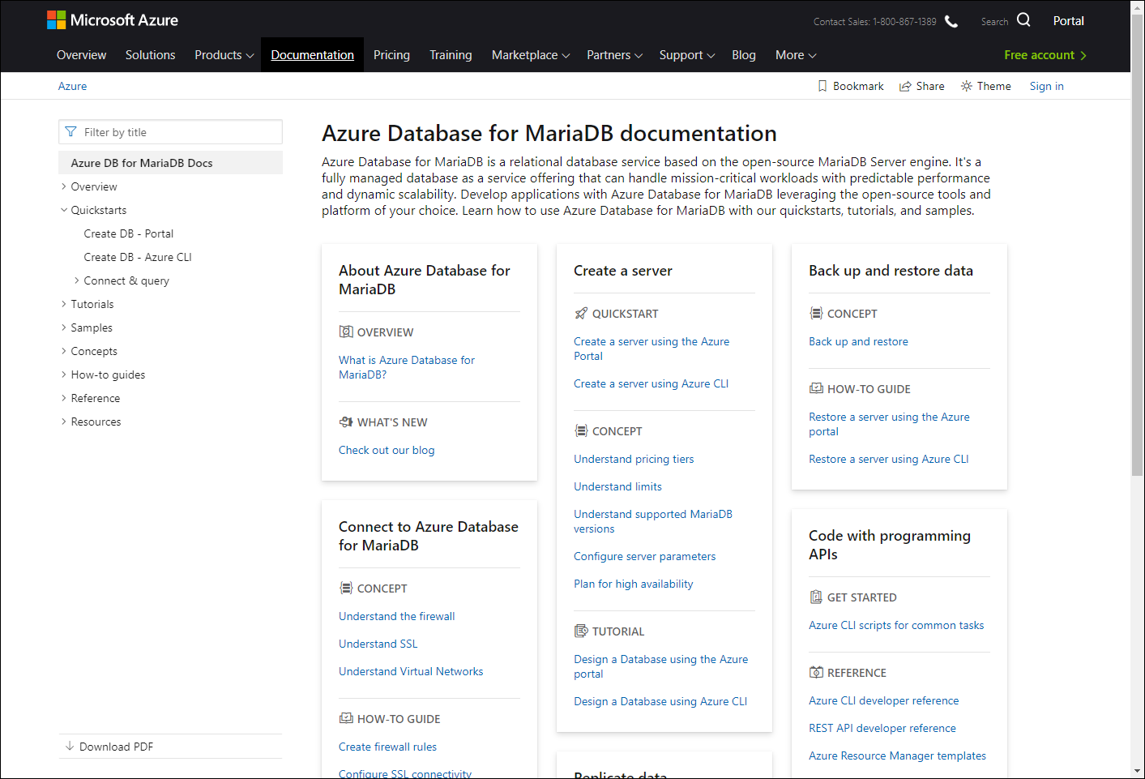
/Docs alert
Explore overviews, tutorials, samples, and more.
aka.ms/azsqldb-afun50
aka.ms/azpostgresql-afun50
aka.ms/azmysql-afun50
aka.ms/azmariadb-afun50

Slide 33
SQL Data Warehouse and Azure Data Factory

Slide 34
The Modern Data Estate
Microsoft’s cloud solution
Operational databases
Data lakes & analytics
Azure SQL Database
for relational data
Azure Data Lake
for processing and analytics on data of any size, shape, and speed
Azure Data Services
Azure Cosmos DB
for non-relational/NoSQL data
Azure Databricks
for big data analytics and AI solutions
Data warehouses
Azure databases for MySQL, PostgreSQL, and MariaDB
for open source
Azure SQL Data Warehouse
for complex queries across petabytes of data
Azure HDInsight
for open source analytics
Reason over any data, anywhere
Security and performance
Flexibility of choice

Slide 35
Cloud Scale Analytics
Modern data warehousing
Advanced analytics
Real-time analytics
" We want to analyze data coming from multiple sources and in varied formats"
" We want to leverage the analytics platform for advanced fraud detection"
“We’re trying to get insights from our devices in real-time”
Azure SQL Data Warehouse
At the core of all use cases is..

Slide 36
Azure SQL Data Warehouse The fast, flexible, and secure hub for all your data
Fast
Unlimited scale
Best in class
price-performance
Secure
Trusted. Compliant. Reliable.
Industry leading security
Flexible
Fits your needs
Intelligent workload management and enhanced concurrency

Slide 37







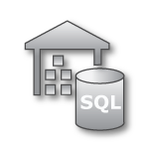




Azure Data Factory
Modernize your enterprise data warehouse at scale
Orchestrate with Azure Data Factory
INGEST
STORE
PREP & TRAIN
MODEL & SERVE
On-premises data
Oracle, SQL, Teradata, fileshares, SAP
Azure Databricks
Cloud data
Azure, AWS, GCP
Azure Data Factory
Azure Blob Storage
Polybase
Azure SQL Data Warehouse
Azure Analysis Services
Power BI
SaaS data
Salesforce, Dynamics

Slide 38
Demo: Data Migration Pipeline with Azure Data Factory

Slide 39
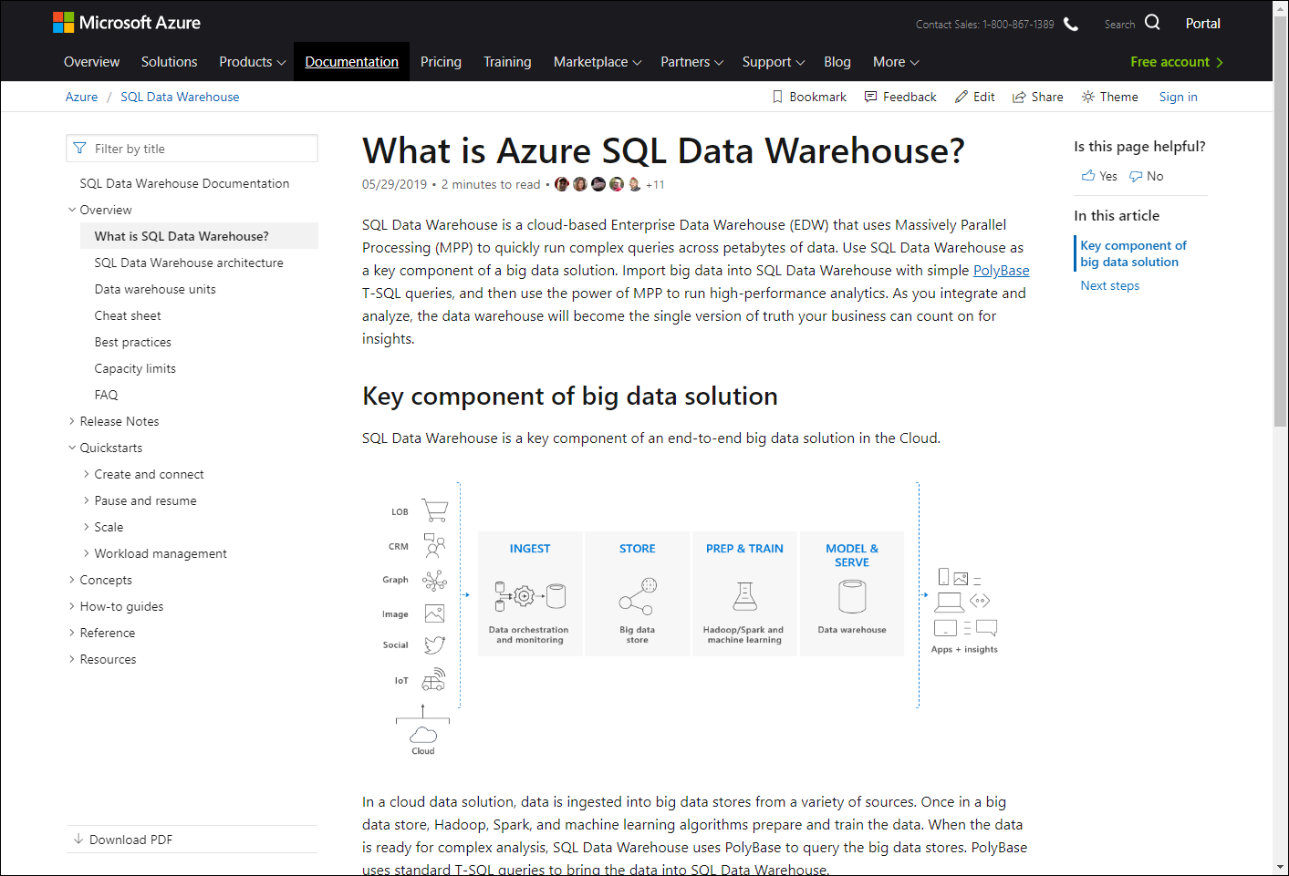
/Docs alert
Explore overviews, tutorials, samples, and more.
aka.ms/azsqldw-afun50
aka.ms/azdatafactory-afun50

Slide 40
Summary
Azure offers a huge variety of options for cloud data storage
There are substantial benefits to moving your data to the cloud
Scalability
Reliability
Simplicity
Built-in intelligence
Fully managed
Global availability

Slide 41

/Microsoft Certification alert
Microsoft Certified:
Azure Data Engineer
aka.ms/dataengineercert-afun50
Get hired, stay ahead, and receive the recognition you deserve
#MSIgnite
#MSIgniteTheTour

Slide 42

Please evaluate this session Your feedback is important to us!
Please evaluate this session through MyEvaluations on the mobile app or website.
Download the app: https://aka.ms/ignite.mobileapp
Go to the website: https://myignite.techcommunity.microsoft.com/evaluations

Slide 43
Visit aka.ms/MicrosoftIgnite2019/AFUN50
Download slides and resources
Access session recordings in 48 hours
Ask questions & continue the conversation
Find this session in Microsoft Tech Community

Slide 44
Invent with purpose.

